Slide 1
Statistical Modeling Explained in Python
Introduction to Data Summarization
Average( Mean, Mode, Median)
Standard Derivation
Variance
IQR
Shahzaib Hamid
AI Sciences Instructor

Slide 2
Module Overview
Summary Statistics
Average
Dispersion
Quick summary
Comparison
Data Properties
Mean
Mode
Median
Standard
Derivation
Variance
IQR

Slide 3


Summary Statistics
Summary Statistics

Slide 4
Overview of Summary Statistics
Provides quick summary
Useful for comparison
Summarizes data properties
Summarizes statistical information

Slide 5
Averages in Summary Statistics
Measure of middle point.
Identify and fix issues.
Types of Averages
Mode
Mean
Median

Slide 6
Mean in Statistics
Mean is a Statistical Concept!
Ratio of the sum of all data samples and number of data samples.
Formula
$$Arithmetic Mean= \frac{x_{1}+x_{2}+…+x_{n}}{n}$$
Where n = Total number of samples

Slide 7
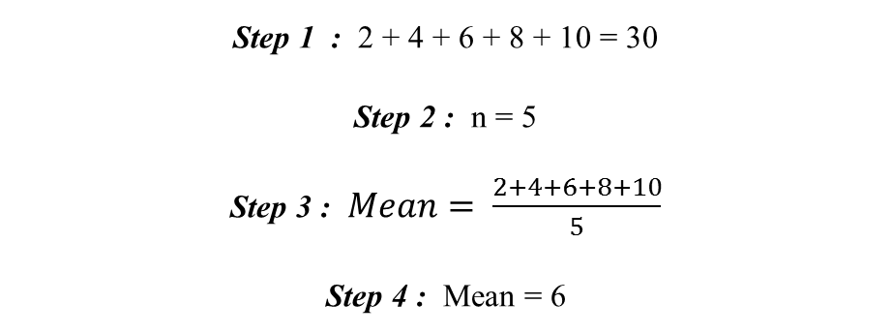
Example
Step 1
Step 2
Step 3
Step 4
Sum all numbers
Count total number of elements
Apply formula
Get Answer
What is the mean of data series 2, 4, 6, 8 and 10?
Step 1 : 2 + 4 + 6 + 8 + 10 = 30
Step 2 : n = 5
Step 3 : $Mean= \frac{2+4+6+8+10}{5}$
Step 4 : Mean = 6

Slide 8
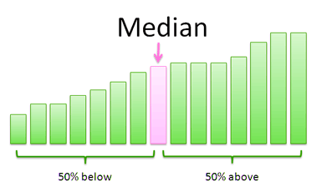
Median in Statistics
Center Value from numbers
Data should be arranged
Median based on two scenarios
Odd Numbers of Observations
Even Numbers of Observations
$$Median= \frac{n+1}{2}$$
$$Median=\left[\frac{\frac{n}{2}+\left(\frac{n}{2}+1\right)}{2}\right]$$
Where n = Total number of samples

Slide 9
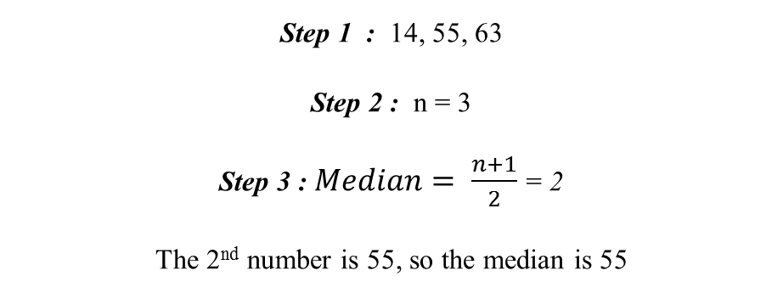
Example
Step 1
Step 2
Step 3
Step 4
Put in ascending
Count the total number
Apply formula
Answer
Find the Median of 14, 63 and 55
Step 1 : 14, 55, 63
Step 2 : n = 3
Step 3 : $Median= \frac{n+1}{2}$ = 2
The 2nd number is 55, so the median is 55

Slide 10
Mode in Statistics
Has higher frequency in data
Mainly has three types
Bimodal mode
Trimodal mode
Multimodal mode

Slide 11
Example
1
[Bimodal]: In the given set of data: 2, 4, 5, 5, 6, 7, the mode of the data set is 5 since it has appeared in the set twice.
2
[Trimodal]: The mode of set A = {2,2,2,3,4,4,5,5,5,7,8,8,8} is 2, 5 and 8.
3
[Multimodal]: In case of more than three modes.

Slide 12
Case Study
Twenty autistic children in a communication therapy program are scored on the number of times in each session that they initiate eye contact or direct a comment toward the primary caretaker.
Here are their scores.
a
Counting from the bottom of the table, what is the ballpark median number of contacts?
b
Using the formula for a median, find the exact median number of contacts
Number of Contacts | Number of Children
8 | 1
6 | 1
5 | 1
4 | 2
3 | 4
2 | 2
1 | 4
c
What will be the mean of both columns of the given dataset?
d
Considering the types of mode, what king of mode can be observed in the Number of Children column of the dataset?

Slide 13
Inter-Quartile Range (IQR)
Difference between the third and the first quartile.
Partitioned values to split values in 2 equal parts
First quartile (Q1): Lower quartile
Third quartile (Q3): Upper quartile
Formula
Interquartile range = Upper Quartile – Lower Quartile = Q­₃ – Q­₁

Slide 14
Example
Recall the previsions example
Your data set is the ages of 8 participants [Even Dataset].
Participants | 1 | 2 | 3 | 4 | 5 | 6 | 7 | 8
Age | 37 | 19 | 31 | 29 | 21 | 26 | 33 | 36
First, order the values from low to high to identify the lowest value (L) and the highest value (H).
25%
Q1
25%
Q2
25%
Q3
25%
Age
19
21
26
29
31
33
36
37
Lower Half
Upper Half
Now find the values of Q1 and Q3
Q1 = (21+26)/2 = 23.5
Q3 = (33+36)/2 = 34.5
IQR = Q3 – Q1 = 34.5 – 23.5 = 11

Slide 15
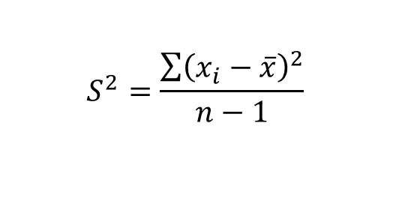
Variance
Expected value of the squared variation of a random variable from its mean value
The value of variance is equal to the square of standard deviation
Variance is represented by σ2,𝑆2or Var(X)
Formula
$$S^{2}=\frac{\sum{{\left(x_{i}−\overline{x}\right)}^{2}}}{n−1}$$

Slide 16
Example
Consider the dataset
Dataset
46 | 69 | 32 | 60 | 52 | 41
Square each deviation from the mean
Squared deviations from the mean
(-4)² = 4 × 4 = 16
19² = 19 × 19 = 361
(-18)² = -18 × -18 = 324
10² = 10 × 10 = 100
2² = 2 × 2 = 4
(-9)² = -9 × -9 = 81
Find Mean
Mean ()
= (46 + 69 + 32 + 60 + 52 + 41) 6 = 50
Find each score’s deviation from the mean
Score | Deviation from the mean
46 | 46 – 50 = -4
69 | 69 – 50 = 19
32 | 32 – 50 = -18
60 | 60 – 50 = 10
52 | 52 – 50 = 2
41 | 41 – 50 = -9
Find the sum of squares
Sum of squares
16 + 361 + 324 + 100 + 4 + 81 = 886
Divide the sum of squares by n – 1 or N
Variance
886 (6 – 1) = 886 5 = 177.2

Slide 17
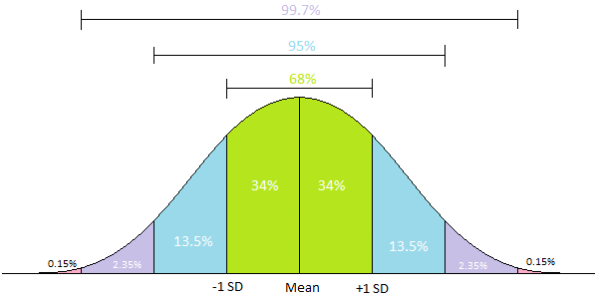
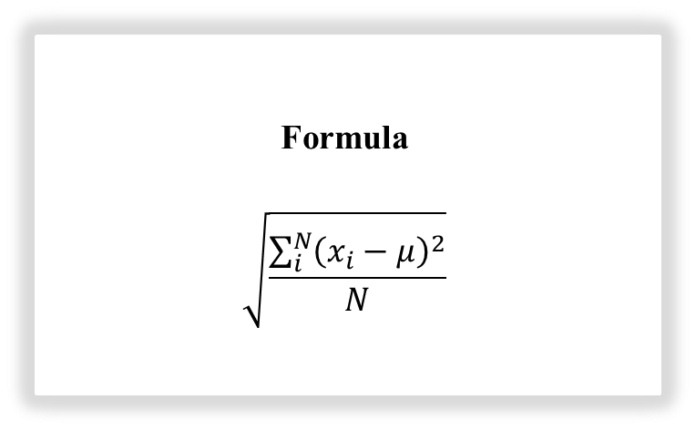
Standard Deviation (σ)
Measure the dispersion
Low standard deviation means data are clustered around the mean.
High standard deviation indicates data are more spread out.
Formula
$$\sqrt{\frac{\sum_{i}^{N}{{\left(x_{i}−μ\right)}^{2}}}{N}}$$

Slide 18
Example
Data set
46 | 69 | 32 | 60 | 52 | 41
Square each deviation from the mean
Squared deviations from the mean
(-4)² = 4 × 4 = 16
19² = 19 × 19 = 361
(-18)² = -18 × -18 = 324
10² = 10 × 10 = 100
2² = 2 × 2 = 4
(-9)² = -9 × -9 = 81
Recall Previous Example
Find Mean
Mean ()
= (46 + 69 + 32 + 60 + 52 + 41) 6 = 50
Find each score’s deviation from the mean
Score | Deviation from the mean
46 | 46 – 50 = -4
69 | 69 – 50 = 19
32 | 32 – 50 = -18
60 | 60 – 50 = 10
52 | 52 – 50 = 2
41 | 41 – 50 = -9
Find the sum of squares
Sum of squares
16 + 361 + 324 + 100 + 4 + 81 = 886
Divide the sum of squares by n – 1 or N
Variance
886 (6 – 1) = 886 5 = 177.2
Take the square root
Standard Deviation = 13.311

